Slide 1
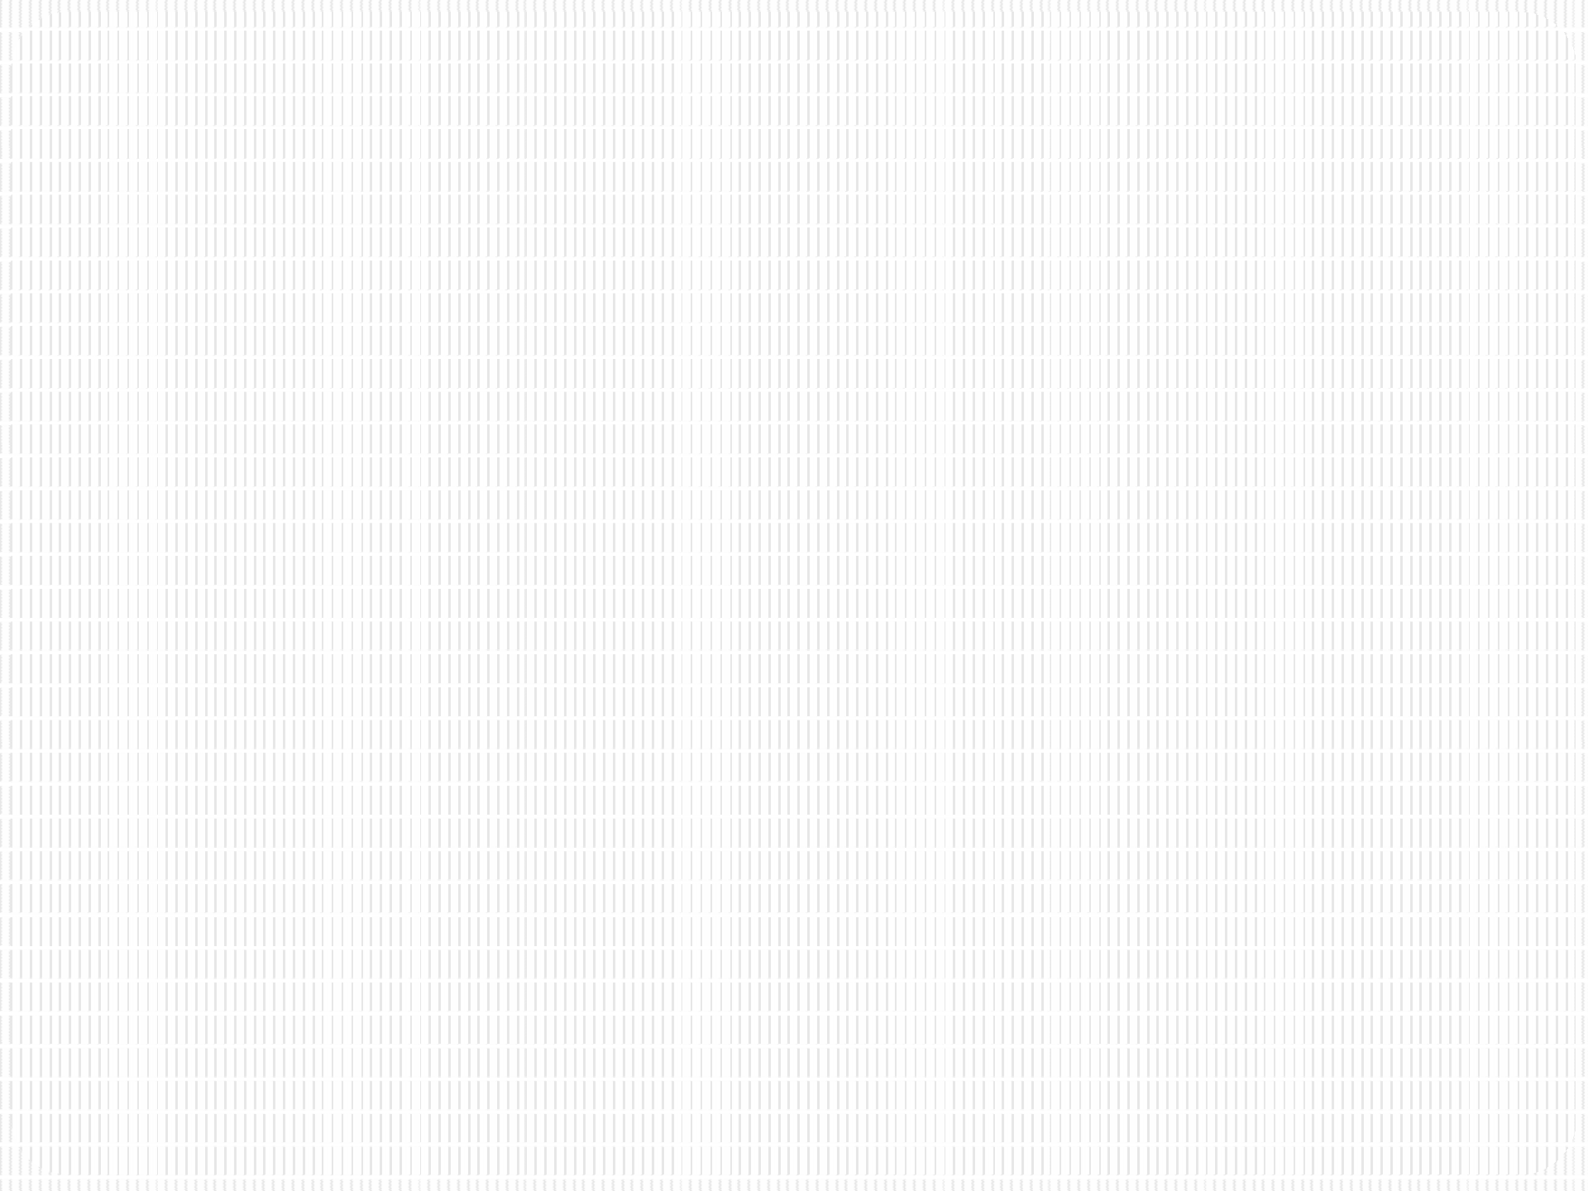


SRM INSTITUTE OF SCIENCE AND TECHNOLOGY
21CSC201J – Data Structures and Algorithms
Unit III- STACK

Slide 2
STACK ADT
Abstract Data Type (ADT)
It is a mathematical model for data types
An abstract data type is defined by its behavior (semantics) from the point of view of a user, of the data, specifically in terms of possible values, possible operations on data of this type, and the behavior of these operations. Set of values and set of operations
A stack is an ADT
It follows Last In First Out (LIFO) methodology perform operations push, pop, etc.

Slide 3
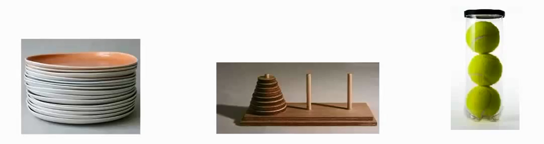
What is STACK?
Diagram Reference : http://www.firmcodes.com/write-a-c-program-to-implement-a-stack-using-an-array-and-linked-list/
Stack works on “Last in First out” or “First in Last Out”, principle.
Plates placed one over another
The plate at the top is removed first & the bottommost plate kept longest period of time.
So, it follows LIFO/FILO order.

Slide 4
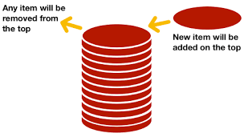
Stack Example
Diagram Reference:https://www.codesdope.com/course/data-structures-stacks/
Always new items are added at top of the stack and also removed from the top of the stack only.
Entry and Exit at same point

Slide 5
STACK – Data Structure
Stack is a Linear Data Structure
Follows a particular order to perform the operations.
The order are either
LIFO(Last In First Out)
OR
FILO(First In Last Out).

Slide 6
STACK - Operations
TWO PRIMARY OPERATIONS
push
Pushing (storing) an element on the stack
If the stack is full, Overflow condition is enabled.
Pop
Removing (accessing) an element from the stack.
The elements are popped in the decreasing order.
If the stack is empty, Underflow condition enabled.

Slide 7
STACK – Additional Functionality
For effective utilization of the stack, Status of the stack should be checked. For that additional functionality is of the stack is given below
Peek or Top
Accessing the top element. Without removing the top element.
isFull
check if stack is full.
isEmpty
check if stack is empty.

Slide 8
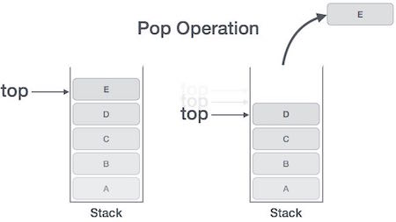
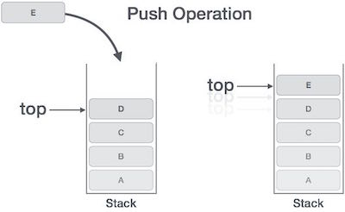
Stack Operation Example

Slide 9
Stack Implementation - Array

Slide 10
Stack - Array
One dimensional array is enough to implement the stack
Array size always fixed
Easy to implement
Create fixed size one dimensional array
insert or delete the elements into the array using LIFO principle using the variable 'top‘

Slide 11
Stack - top
About top
Initial value of the top is -1
To insert a value into the stack, increment the top value by one and then insert
To delete a value from the stack, delete the top value and decrement the top value by one

Slide 12
Steps to create an empty stack
Declare the functions like push, pop, display etc. need to implement the stack.
Declare one dimensional array with fixed size
Declare a integer variable 'top' and initialize it with '-1'. (int top = -1)

Slide 13
push(Value) Inserting value into the stack
push() is a function used to insert a new element into stack at top position.
Push function takes one integer value as parameter
Check whether stack is FULL based on (top == SIZE-1)
If stack is FULL, then display "Stack is FULL Not able to Insert element” and terminate the function.
If stack is NOT FULL, then increment top value by one (top=top+1) and set (stack[top] = value)

Slide 14
pop() – Delete a value from the Stack
pop() is a function used to delete an element from the stack from top position
Pop function does not take any value as parameter
Check whether stack is EMPTY using (top == -1)
If stack is EMPTY, then display "Stack is EMPTY No elements to delete" and terminate the function
If stack is NOT EMPTY, then delete stack[top] and decrement top value by one (top=top-1)

Slide 15
display() Displays the elements of a Stack
display() – function used to Display the elements of a Stack
Check whether stack is EMPTY based on (top == -1)
If stack is EMPTY, then display "Stack is EMPTY" and terminate the function
If stack is NOT EMPTY, display the value in decreasing order of array

Slide 16
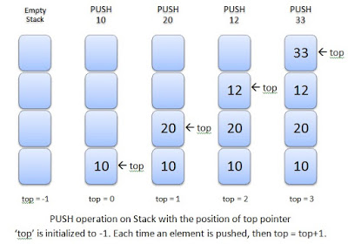
Stack Push Example
Diagram reference :http://www.exploredatabase.com/2018/01/stack-abstract-data-type-data-structure.html

Slide 17
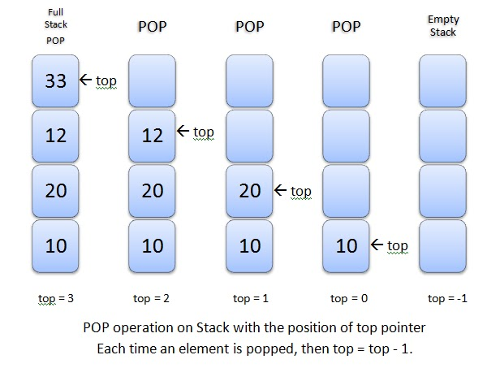
Stack Pop Example

Slide 18
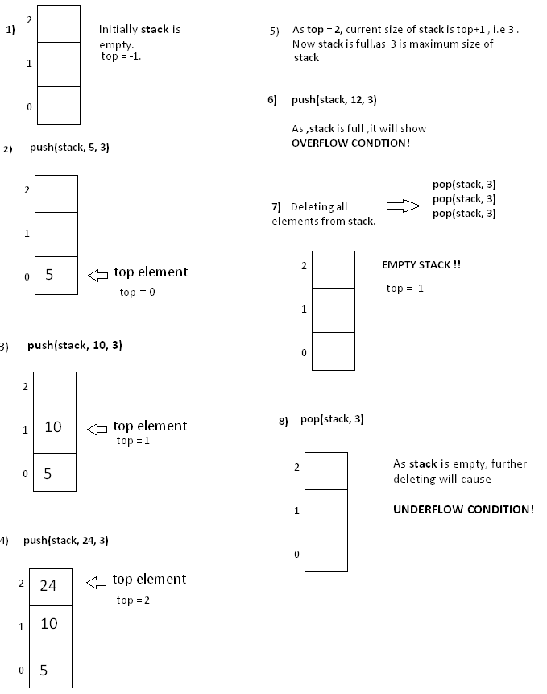
Another Example of Stack Push & Pop
Image Reference : https://www.hackerearth.com/practice/notes/stacks-and-queues/

Slide 19
Cons Stack - Array
The size of the array should be mentioned at the beginning of the implementation
If more memory needed or less memory needed that time this array implementation is not useful

Slide 20
Stack Implementation – Linked List

Slide 21
Pros Stack – Linked List
A stack data structure can be implemented by using a linked list
The stack implemented using linked list can work for the variable size of data. So, there is no need to fix the size at the beginning of the implementation

Slide 22
Stack – Linked list
Dynamic Memory allocation of Linked list is followed
The nodes are scattered and non-contiguously in the memory
Each node contains a pointer to its immediate successor node in the stack
Stack is said to be overflown if the space left in the memory heap is not enough to create a node

Slide 23
Stack – Linked list
In linked list implementation of a stack, every new element is inserted as 'top' element.
That means every newly inserted element is pointed by 'top'.
To remove an element from the stack, simply remove the node which is pointed by 'top' by moving 'top' to its previous node in the list.
The next field of the First element must be always NULL.

Slide 24
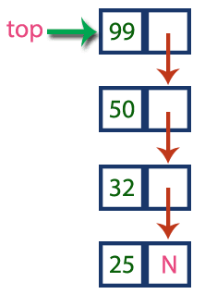
Example Stack – Linked List
Diagram Reference :http://www.btechsmartclass.com/data_structures/stack-using-linked-list.html

Slide 25
Create Node – Linked List
Include all the header files which are used in the program. And declare all the user defined functions
Define a 'Node' structure with two members data and next
Define a Node pointer 'top' and set it to NULL
Implement the main method by displaying Menu with list of operations and make suitable function calls in the main method

Slide 26
push(value) Inserting an element into the Stack
Create a newNode with given value
Check whether stack is Empty (top == NULL)
If it is Empty, then set newNode → next = NULL
If it is Not Empty, then set newNode → next = top
Finally, set top = newNode

Slide 27
pop() Deleting an Element from a Stack
Check whether stack is Empty (top == NULL)
If it is Empty, then display "Stack is Empty!!! Deletion is not possible!!!" and terminate the function
If it is Not Empty, then define a Node pointer 'temp' and set it to 'top‘
Then set 'top = top → next‘
Finally, delete 'temp'. (free(temp))

Slide 28
display() Displaying stack of elements
Check whether stack is Empty (top == NULL)
If it is Empty, then display 'Stack is Empty!!!' and terminate the function
If it is Not Empty, then define a Node pointer 'temp' and initialize with top
Display 'temp → data --->' and move it to the next node. Repeat the same until temp reaches to the first node in the stack. (temp → next != NULL)
Finally! Display 'temp → data ---> NULL'

